Slide 1
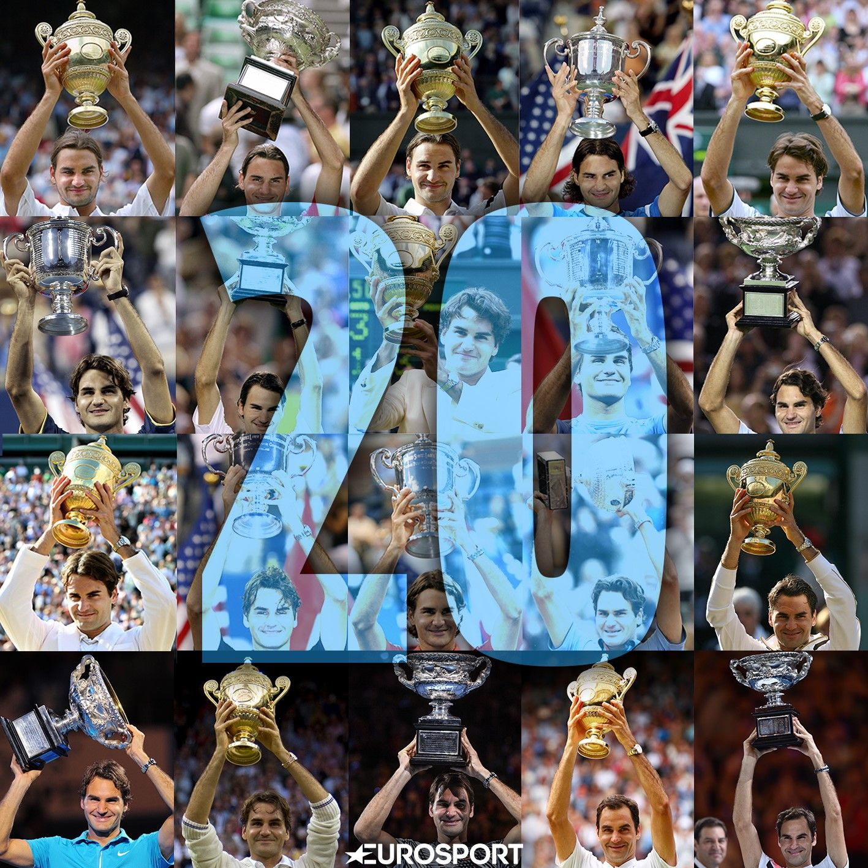
Roger Federer : The Making of a Champion
BAX 431 001 Assignment 2
Japsowin Kaur
Image Source: https://tinyurl.com/r9ws6xg

Slide 2
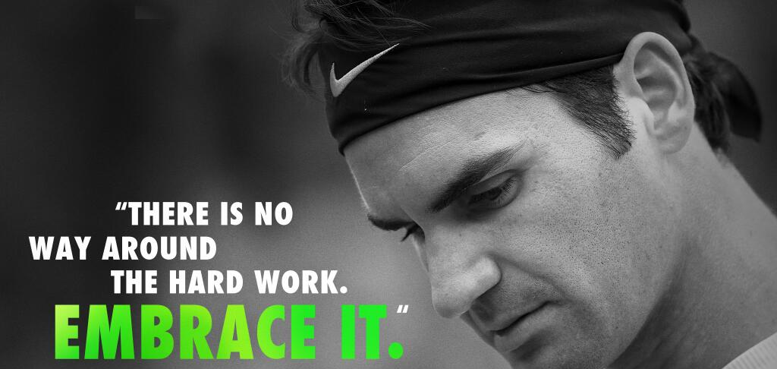
Roger Federer is widely regarded as the Greatest of All Time in the history Men’s Lawn Tennis. He attributes it to hard work, continuous reinvention and family support. But what do his career statistics tell us about his game and how can other players and coaches learn from these numbers?
Image Source: https://tinyurl.com/vpphhu5

Slide 3
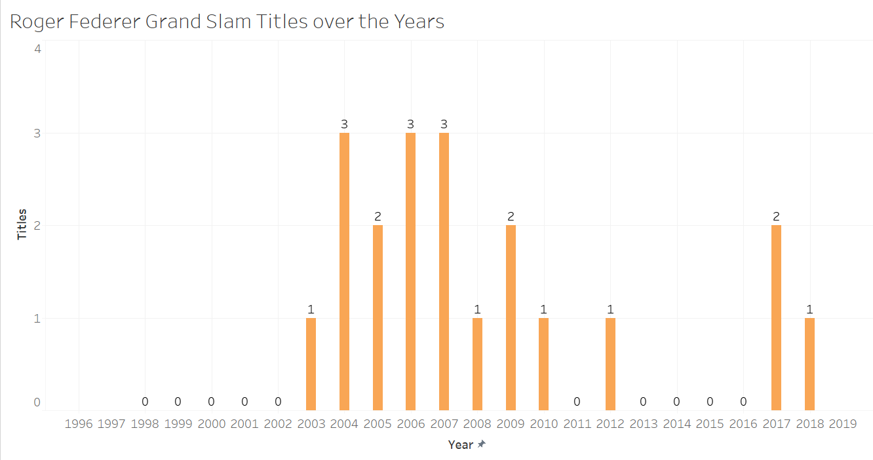
Career Stats: 20 Grand Slams Won
20
The highest number of Grand Slam Titles won in the history of Men’s Tennis

Slide 4
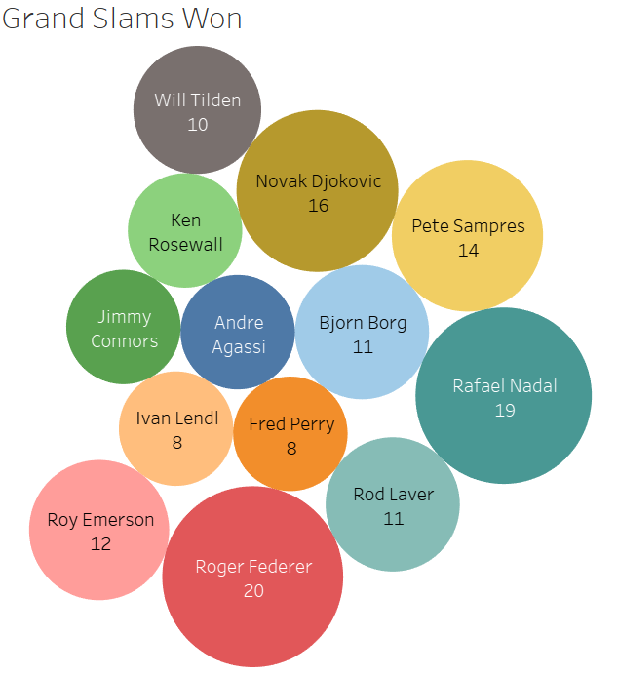
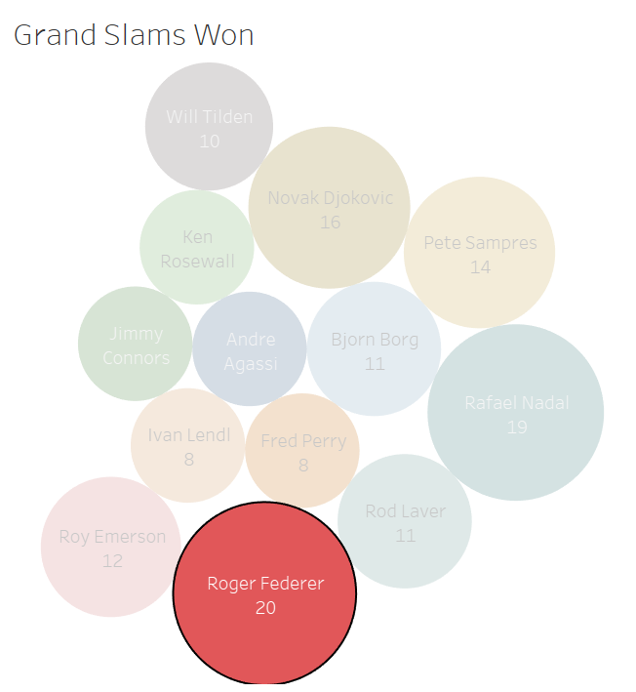
Career Stats: An overview of Men’s Tennis
Federer still ahead in the Grand Slam race at the age of 38!
How does he do it?

Slide 5
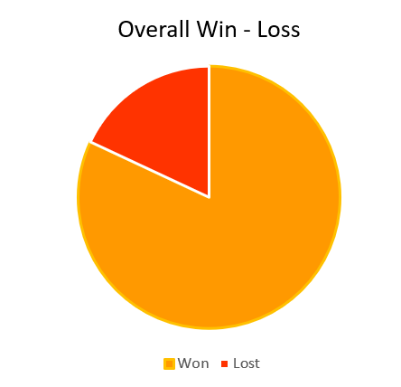
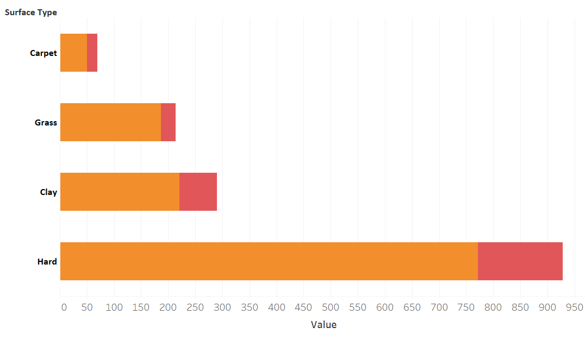
Success on different surfaces
Carpet
73%
Grass
87%
18%
Clay
76%
82%
Hard
83%
Matches
Federer has performed exceptionally well on grass courts and hard courts

Slide 6
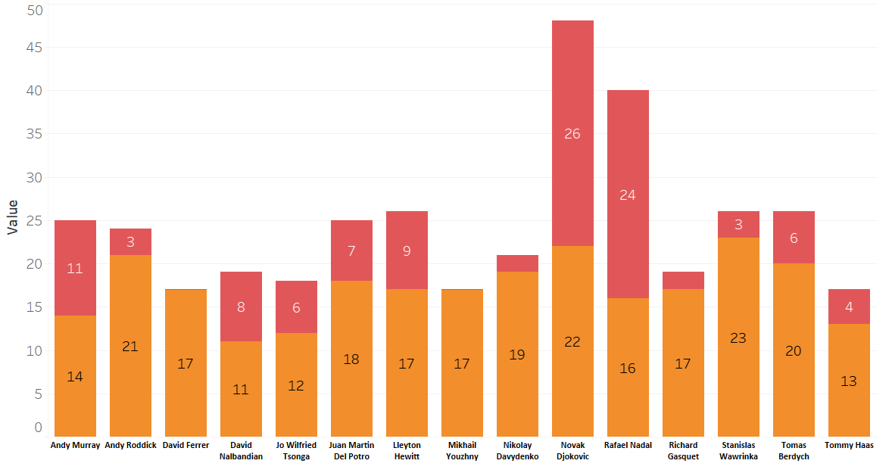
Success against opponents
Djokovic and Nadal are the only two players with a > 50% win rate against Federer
Matches Played
Opponent Name

Slide 7
The 6 key metrics in tennis
Number of Aces
% First serve points won
% Second Serve points won
% Return games won
% Break points converted
% Break points saved
Performance across all these metrics determine a player’s overall success rate

Slide 8
Roger Federer’s performance across the 6 key metrics
Vs
Average performance of top 100 players

Slide 9
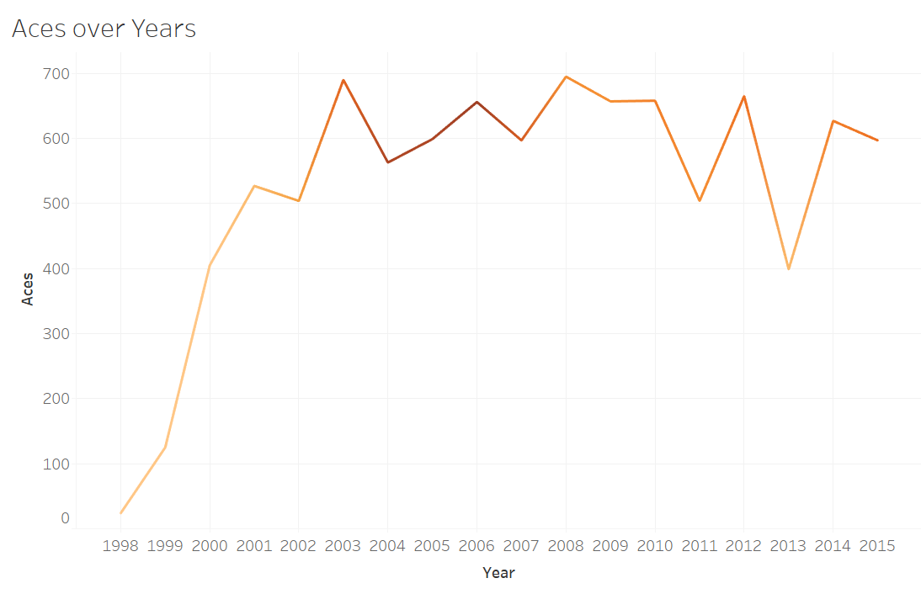
Aces
Roger Federer:
3rd ever highest average
387
Top 30 players’ average
248
Top 100 players’ average

Slide 10
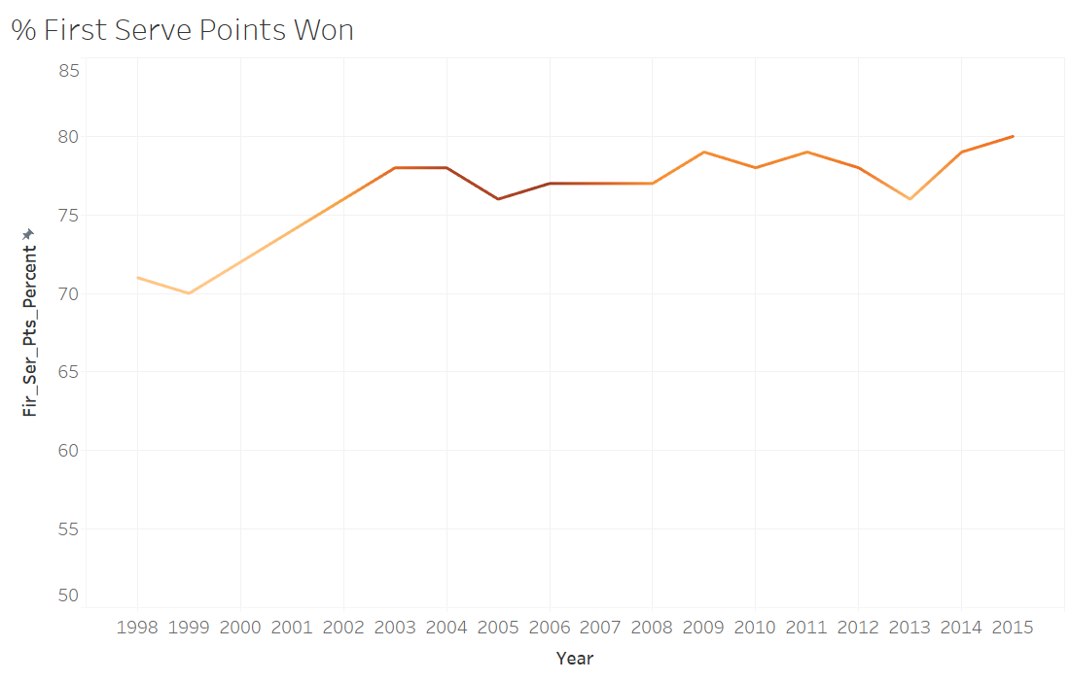
% First serve points won
75.5%
Roger Federer:
20th ever highest average
Top 100 players’ average

Slide 11
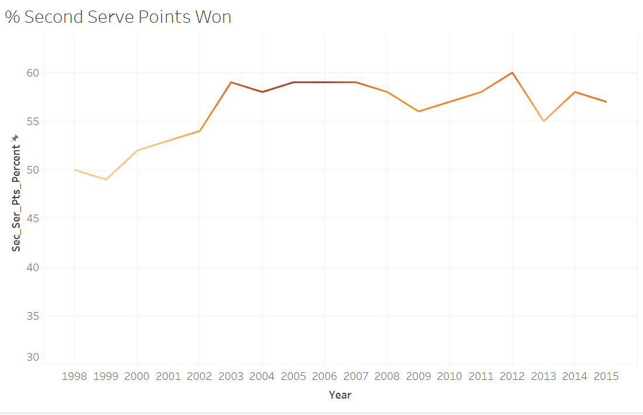
% Second Serve points won
Roger Federer:
2nd ever highest average
52.3 %
Top 100 players’ average

Slide 12
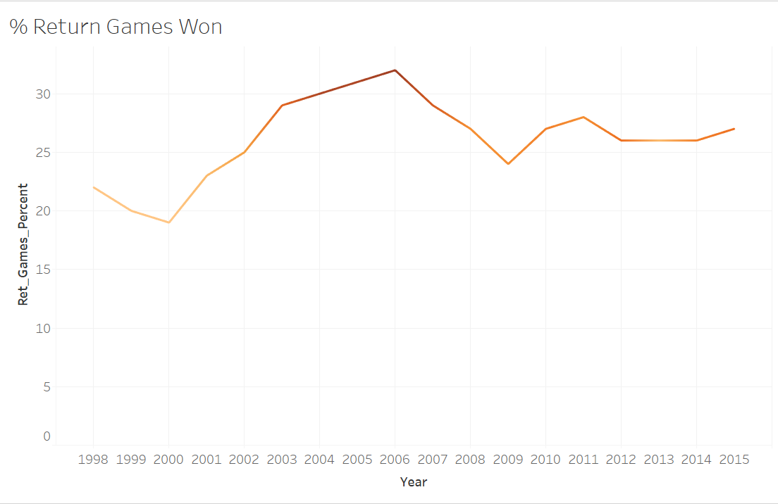
% Return Games Won
27.6 %
Top 100 players’ average
Roger Federer:
55th ever highest average
Federer isn’t among the strongest returners in the sport

Slide 13
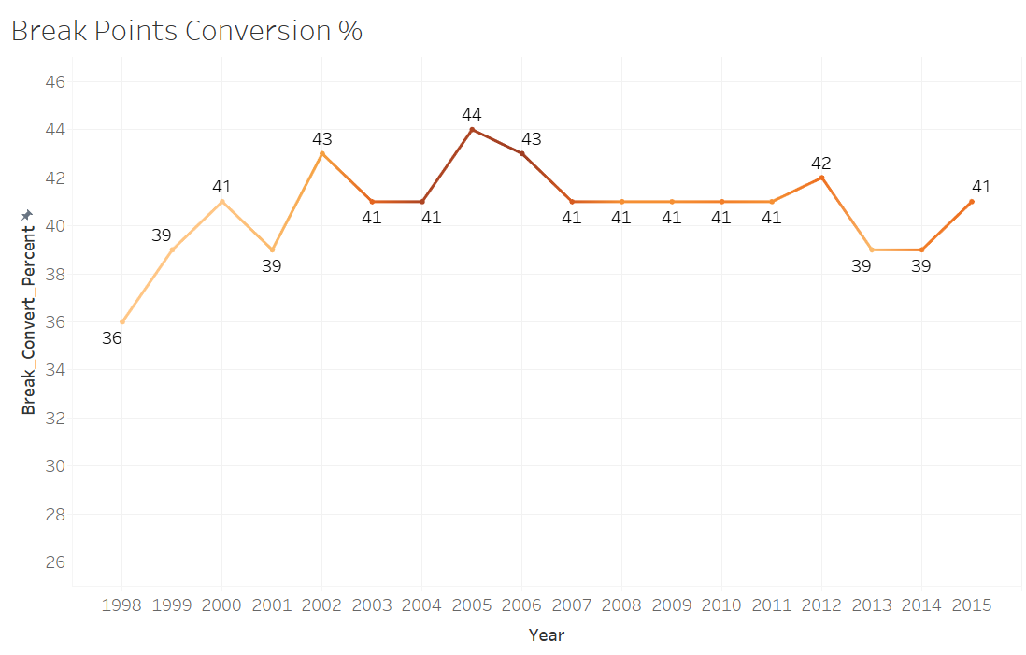
% Break points converted
42.23 %
Top 100 players’ average
Roger Federer:
90th ever highest average
Federer does not have a great record in converting break points

Slide 14
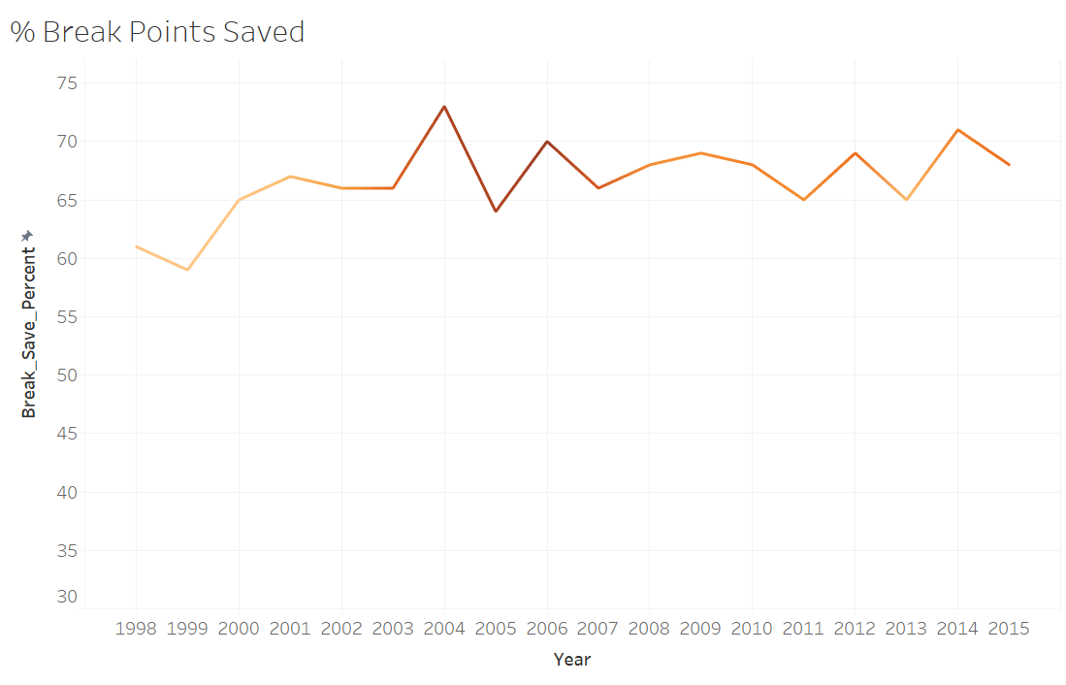
% Break Points Saved
63.62 %
Top 100 players’ average
Roger Federer:
7th ever highest average

Slide 15
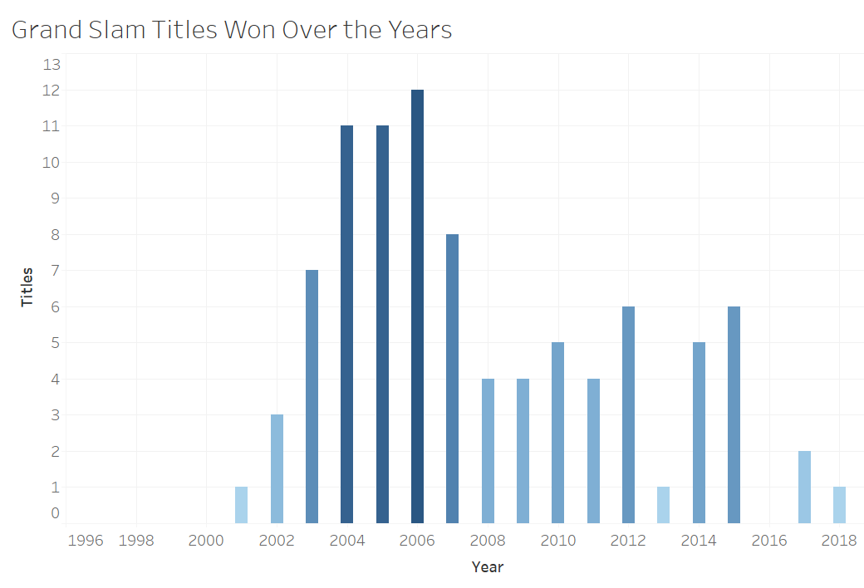
Grand Slams won
Roger Federer:
20 - Highest number of Grand Slam titles won in the history of men’s tennis

Slide 16
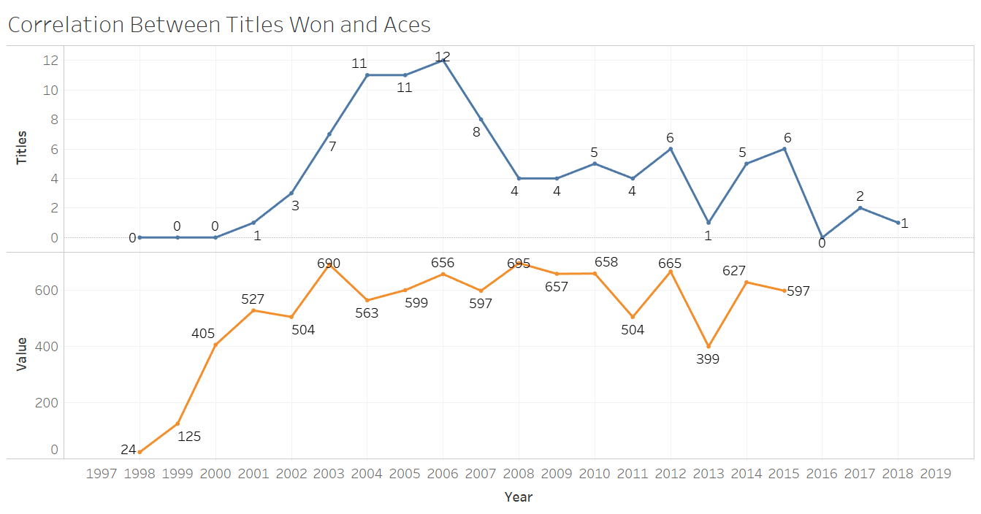
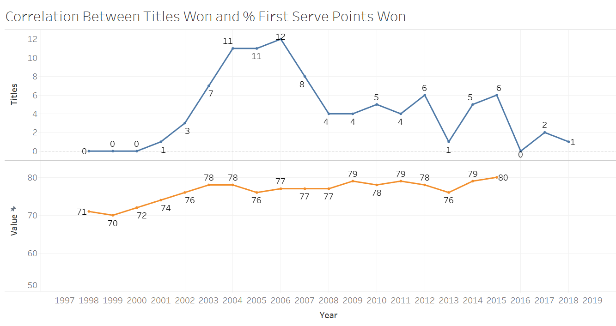
Trends: Grand Slams won and metrics
As Federer started playing greater number of aces, and winning a higher % of first serve points, he started winning Grand Slams.
The dip in 2013 was due to a back injury that he suffered. He made his comeback in 2017 winning 2 Grand Slams that year, playing in sublime form!
Drop in form
due to back injury

Slide 17
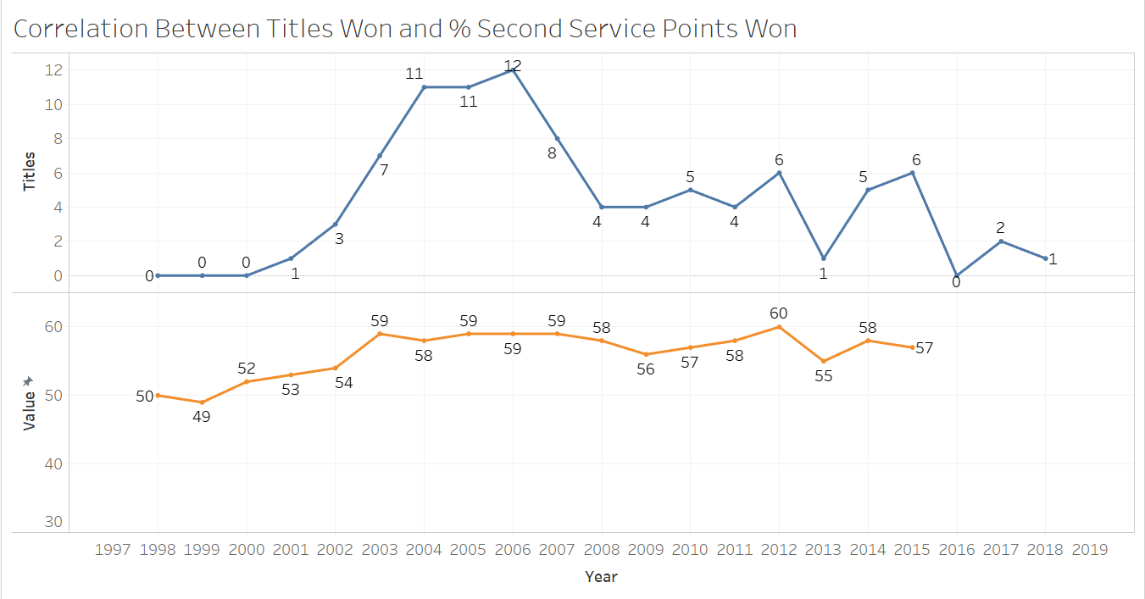
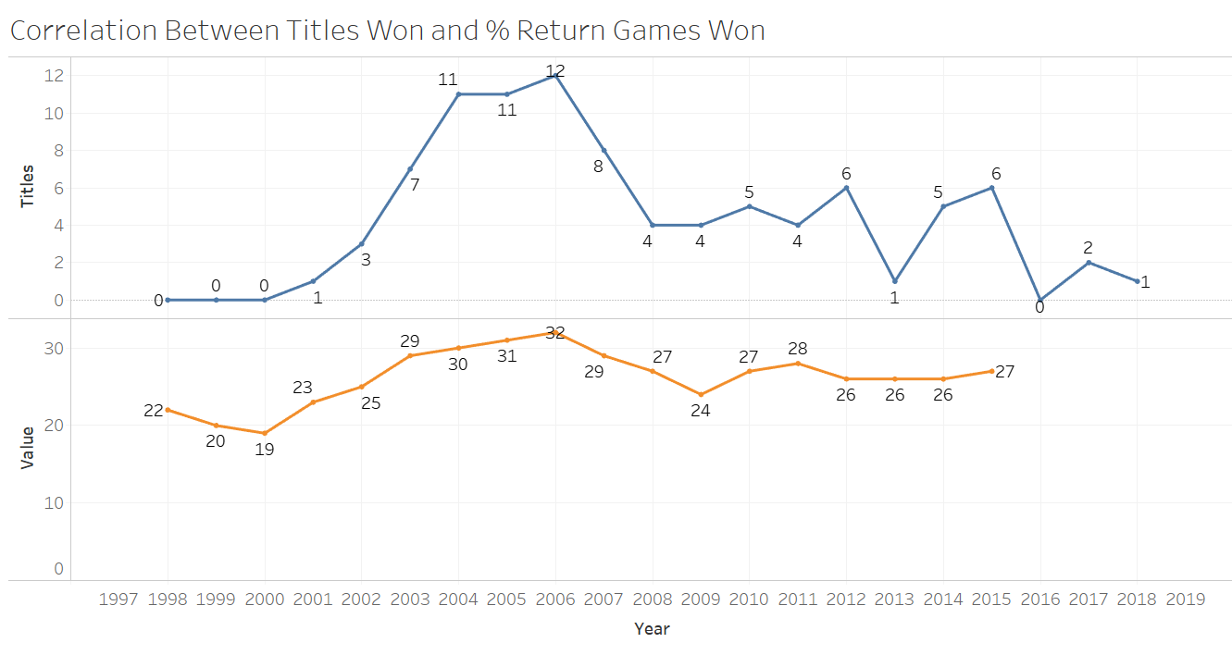
Trends: Grand Slams won and metrics
Federer’s strong first and second serve generally compensate for his weak % of return games won.
Against strong returners, he comes up a different game plan to tackle the challenges

Slide 18
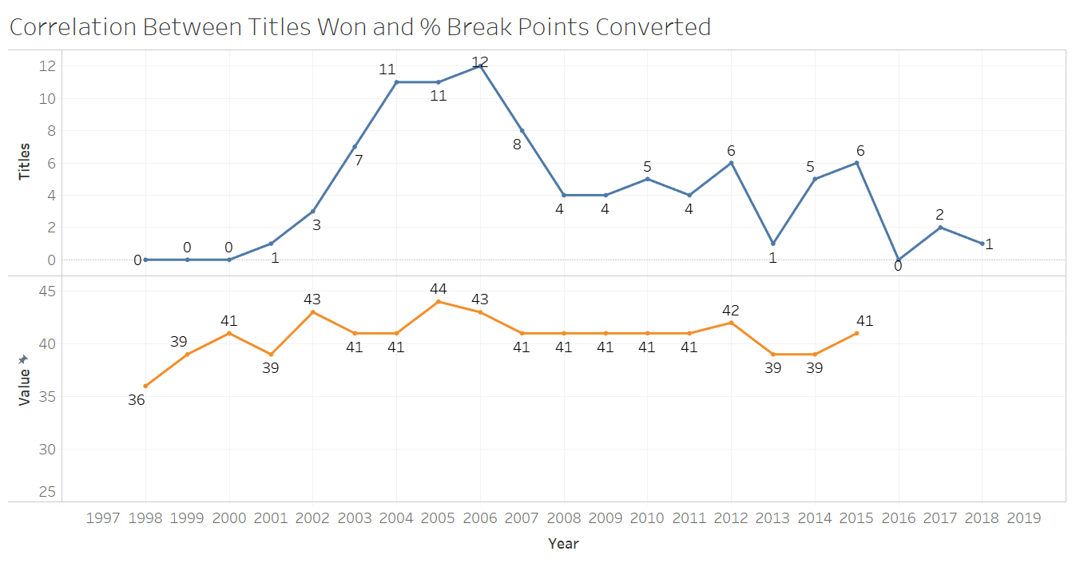
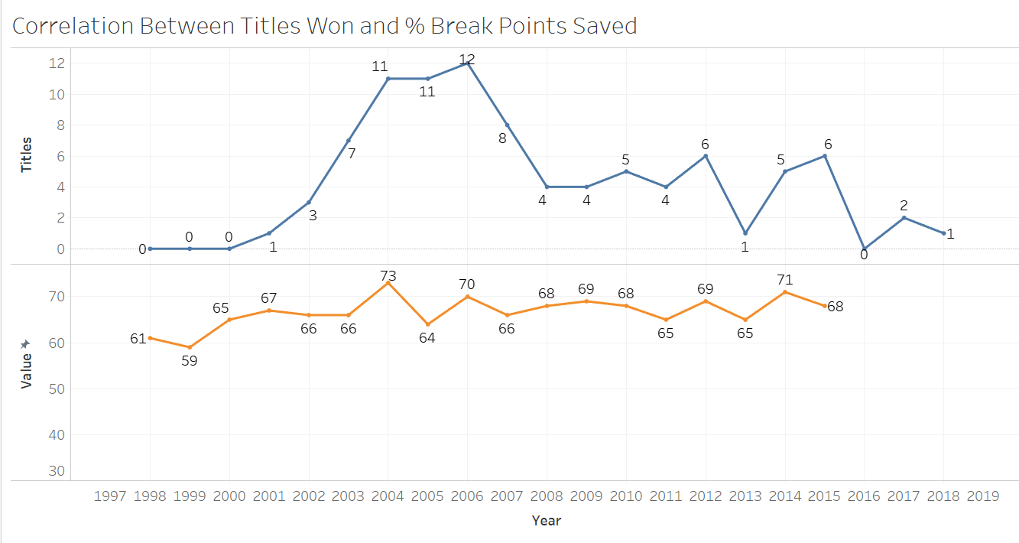
Trends: Grand Slams won and metrics
Although Federer has a weak record in converting break points, his strong serve and high percentage numbers for break points saved, give him enough opportunities to tilt the scales in his favor

Slide 19
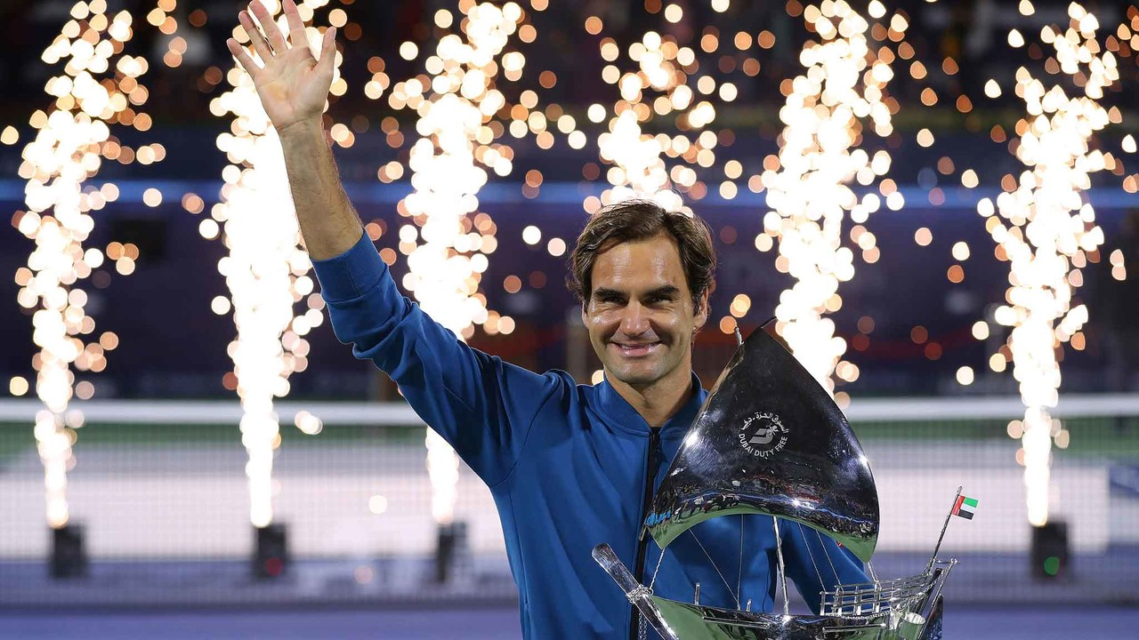
Talent, hardwork, attention to detail coupled with staggering game statistics have led to astounding success for Federer! What he lacks in some metrics, he makes up in others producing one of the strongest games the sport has ever witnessed. He recently won 103rd career title, the second highest in the history of men’s tennis, only 6 behind all time leader, Jimmy Connors
Image source and linked article: https://tinyurl.com/tany8ye

Slide 20

Image Source: https://tinyurl.com/rl6x29l

Slide 21
Appendix

Slide 22
A tribute to Federer’s 20 Grand Slam wins: https://www.youtube.com/watch?v=-uhipfpU2AQ

Slide 23
Sources and References
https://scroll.in/field/915291/data-check-roger-federers-100-atp-titles-and-what-it-tells-us-about-his-spectacular-career
http://www.tennisabstract.com/cgi-bin/player.cgi?p=RogerFederer#head-to-heads-h
https://data.world/nrippner/roger-federer
https://www.tennisprofiler.com/federer
https://www.statista.com/statistics/263034/male-tennis-players-with-the-most-victories-at-grand-slam-tournaments/
https://www.atptour.com/en/stats/service-games-won
https://www.hubgets.com/blog/biggest-secret-behind-roger-federer-success/
https://www.dansilvestre.com/roger-federer-career/
https://www.eurosport.com/tennis/australian-open/2018/tennis-roger-federer-s-grand-slam-records-in-numbers_sto6503057/story.shtml
https://www.youtube.com/watch?v=-uhipfpU2AQ
https://www.usopen.org/en_US/news/articles/2019-03-02/2019-03-03_roger_federer_wins_100th_career_title.html

